Slide 1
Knowledge-based recommendation

Slide 2


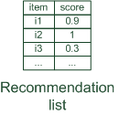




Basic I/O Relationship
Knowledge-based: "Tell me what fits based on my needs"

Slide 3


Why do we need knowledge-based recommendation?
Products with low number of available ratings
Time span plays an important role
five-year-old ratings for computers
user lifestyle or family situation changes
Customers want to define their requirements explicitly
"the color of the car should be black"

Slide 4
Knowledge-based recommender systems
Constraint-based
based on explicitly defined set of recommendation rules
fulfill recommendation rules
Case-based
based on different types of similarity measures
retrieve items that are similar to specified requirements
Both approaches are similar in their conversational recommendation process
users specify the requirements
systems try to identify solutions
if no solution can be found, users change requirements

Slide 5
Constraint-based recommender systems
Knowledge base
usually mediates between user model and item properties
variables
user model features (requirements), Item features (catalogue)
set of constraints
logical implications (IF user requires A THEN proposed item should possess feature B)
hard and soft/weighted constraints
solution preferences
Derive a set of recommendable items
fulfilling set of applicable constraints
applicability of constraints depends on current user model
explanations – transparent line of reasoning

Slide 6
Constraint-based recommendation tasks
Find a set of user requirements such that a subset of items fulfills all constraints
ask user which requirements should be relaxed/modified such that some items exist that do not violate any constraint
Find a subset of items that satisfy the maximum set of weighted constraints
similar to find a maximally succeeding subquery (XSS)
all proposed items have to fulfill the same set of constraints
compute relaxations based on predetermined weights
Rank items according to weights of satisfied soft constraints
rank items based on the ratio of fulfilled constraints
does not require additional ranking scheme

Slide 7
Constraint-based recommendation problem
Select items from this catalog that match the user's requirements
User's requirements can, for example, be
"the price should be lower than 300 €"
"the camera should be suited for sports photography"
id | price(€) | mpix | opt-zoom | LCD-size | movies | sound | waterproof
P₁ | 148 | 8.0 | 4× | 2.5 | no | no | yes
P₂ | 182 | 8.0 | 5× | 2.7 | yes | yes | no
P₃ | 189 | 8.0 | 10× | 2.5 | yes | yes | no
P₄ | 196 | 10.0 | 12× | 2.7 | yes | no | yes
P₅ | 151 | 7.1 | 3× | 3.0 | yes | yes | no
P₆ | 199 | 9.0 | 3× | 3.0 | yes | yes | no
P₇ | 259 | 10.0 | 3× | 3.0 | yes | yes | no
P₈ | 278 | 9.1 | 10× | 3.0 | yes | yes | yes

Slide 8
Constraint satisfaction problem (CSP)
A knowledge-based RS with declarative knowledge representation
Def.
X_{I}, X_{U}: Variables describing product and user model with domain D
KB: Knowledge base with domain restrictions (e.g. if purpose=on travel then lower focal length < 28mm)
SRS: Specific requirements of user (e.g. purpose = on travel)
I: Product catalog
Solution: Assignment tuple
is satisfiable

Slide 9
Conjunctive query
Different from a constraint solver
it is not to find valid instantiations for a CSP
Conjunctive query is executed in the item catalog
a conjunctive database query
a set of selection criteria that are connected conjunctively
σ[criteria](P)
P: product assortment
example: σ[mpix≥10, price<300](P) = {p4, p7}

Slide 10
Interacting with constraint-based recommenders
The user specifies his or her initial preferences
all at once or
incrementally in a wizard-style
interactive dialog
The user is presented with a set of matching items
with explanation as to why a certain item was recommended
The user might revise his or her requirements
see alternative solutions
narrow down the number of matching items

Slide 11
Defaults
Support customers to choose a reasonable alternative
unsure about which option to select
simply do not know technical details
Type of defaults
static defaults
dependent defaults
derived defaults
Selecting the next question
most users are not interested in specifying values for all properties
identify properties that may be interesting for the user

Slide 12
Unsatisfied requirements
"no solution could be found"
Constraint relaxation
the goal is to identify relaxations to the original set of constraints
relax constraints of a recommendation problem until a corresponding solution has been found
Users could also be interested in repair proposals
recommender can calculate a solution by adapting the proposed requirements

Slide 13
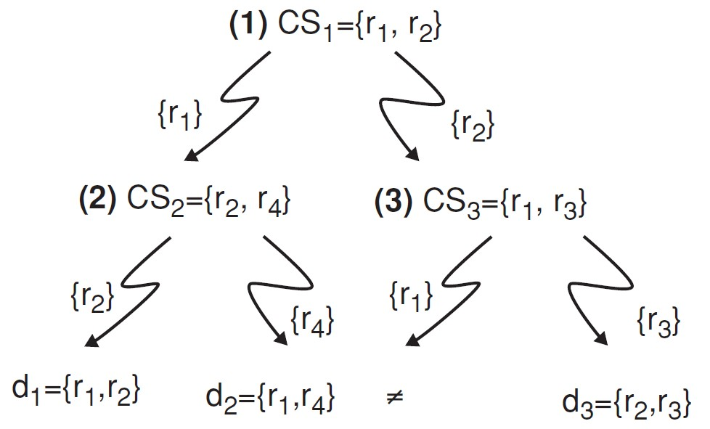
Deal with unsatisfied requirements
Calculate diagnoses for unsatisfied requirements
The diagnoses derived from the conflict sets {CS1,CS2,CS3} are {d1:{r1, r2}, d2:{r1, r4},d3:{r2, r3}}

Slide 14
QuickXPlain
Calculate conflict sets
Algorithm 4.1 QuickXPlain(P, REQ)
Input: trusted knowledge (items) P; Set of requirements REQ
Output: minimal conflict set CS
if σ_{[REQ]}(P) = ∅ or REQ = ∅ then return ∅
else return QX' (P, ∅, ∅, REQ);
Function QX' (P, B, Δ, REQ)
if = ∅ and σ_{[B]}(P) = ∅ then return ∅;
if REQ = {r} then return {r};
let {r₁, . . . , r_{n}} = REQ;
let k be n/2;
REQ₁ ←r₁, . . . , r_{k} and REQ₂ ←r_{k+1}, . . . , rn;
Δ₂ ←QX(P, B ∪ REQ₁, REQ₁, REQ₂);
Δ₁ ←QX(P, B ∪ Δ 2, Δ 2, REQ₁);
return Δ₁ ∪ Δ₂;

Slide 15
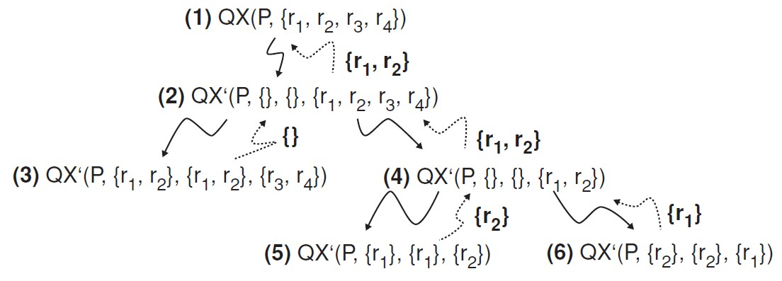
Example of QuickXPlain
id | Price(€) | mpix | opt-zoom | LCD-size | movies | sound | waterproof
P₁ | 148 | 8.0 | 4× | 2.5 | no | no | yes
P₂ | 182 | 8.0 | 5× | 2.7 | yes | yes | no
P₃ | 189 | 8.0 | 10× | 2.5 | yes | yes | no
P₄ | 196 | 10.0 | 12× | 2.7 | yes | no | yes
P₅ | 151 | 7.1 | 3× | 3.0 | yes | yes | no
P₆ | 199 | 9.0 | 3× | 3.0 | yes | yes | no
P₇ | 259 | 10.0 | 3× | 3.0 | yes | yes | no
P₈ | 278 | 9.1 | 10× | 3.0 | yes | yes | yes
REQ = {r1:price≤150, r2:opt-zoom=5x, r3:sound=yes, r4:waterproof=yes}

Slide 16
Repairs for unsatisfied requirements
Identify possible adaptations
Or query the product table P with π[attributes(d)]σ[REQ−d](P)
π[attributes(d1)]σ[REQ−d1](P) = {price=278, opt-zoom=10×}
π[attributes(d2)]σ[REQ−d2](P) = {price=182, waterproof=no}
π[attributes(d3)]σ[REQ−d3](P) = {opt-zoom=4×, sound=no}
repair | price(€) | opt-zoom | sound | waterproof
Rep₁ | 278 | 10× | √ | √
Rep₂ | 182 | √ | √ | no
Rep₃ | √ | 4× | no | √

Slide 17
Ranking the items
Multi-attribute utility theory
each item is evaluated according to a predefined set of dimensions that provide an aggregated view on the basic item properties
E.g. quality and economy are dimensions in the domain of digital cameras
id | value | quality | economy
price | ≤250 >250 | 5 10 | 10 5
mpix | ≤8 >8 | 4 10 | 10 6
opt-zoom | ≤9 >9 | 6 10 | 9 6
LCD-size | ≤2.7 >2.7 | 6 9 | 10 5
movies | Yes no | 10 3 | 7 10
sound | Yes no | 10 7 | 8 10
waterproof | Yes no | 10 8 | 6 10

Slide 18
Item utility for customers
Customer specific interest
Calculation of Utility
Customer | quality | economy
Cu₁ | 80% | 20%
Cu₂ | 40% | 60%
quality | economy | cu₁ | cu₂
P₁ Σ(5,4,6,6,3,7,10) = 41 | Σ (10,10,9,10,10,10,6) = 65 | 45.8 [8] | 55.4 [6]
P₂ Σ(5,4,6,6,10,10,8) = 49 | Σ (10,10,9,10,7,8,10) = 64 | 52.0 [7] | 58.0 [1]
P₃ Σ(5,4,10,6,10,10,8) = 53 | Σ (10,10,6,10,7,8,10) = 61 | 54.6 [5] | 57.8 [2]
P₄ Σ(5,10,10,6,10,7,10) = 58 | Σ (10,6,6,10,7,10,6) = 55 | 57.4 [4] | 56.2 [4]
P₅ Σ(5,4,6,10,10,10,8) = 53 | Σ (10,10,9,6,7,8,10) = 60 | 54.4 [6] | 57.2 [3]
P₆ Σ(5,10,6,9,10,10,8) = 58 | Σ (10,6,9,5,7,8,10) = 55 | 57.4 [3] | 56.2 [5]
P₇ Σ(10,10,6,9,10,10,8) = 63 | Σ (5,6,9,5,7,8,10) = 50 | 60.4 [2] | 55.2 [7]
P₈ Σ(10,10,10,9,10,10,10) = 69 | Σ (5,6,6,5,7,8,6) = 43 | 63.8 [1] | 53.4 [8]

Slide 19
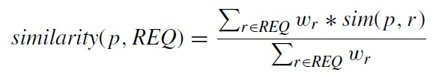

Case-based recommender systems
Items are retrieved using similarity measures
Distance similarity
Def.
sim (p, r) expresses for each item attribute value φr (p) its distance to the customer requirement r ∈ REQ.
wr is the importance weight for requirement r
In real world, customer would like to
maximize certain properties. i.e. resolution of a camera, "more is better"(MIB)
minimize certain properties. i.e. price of a camera, "less is better"(LIB)

Slide 20
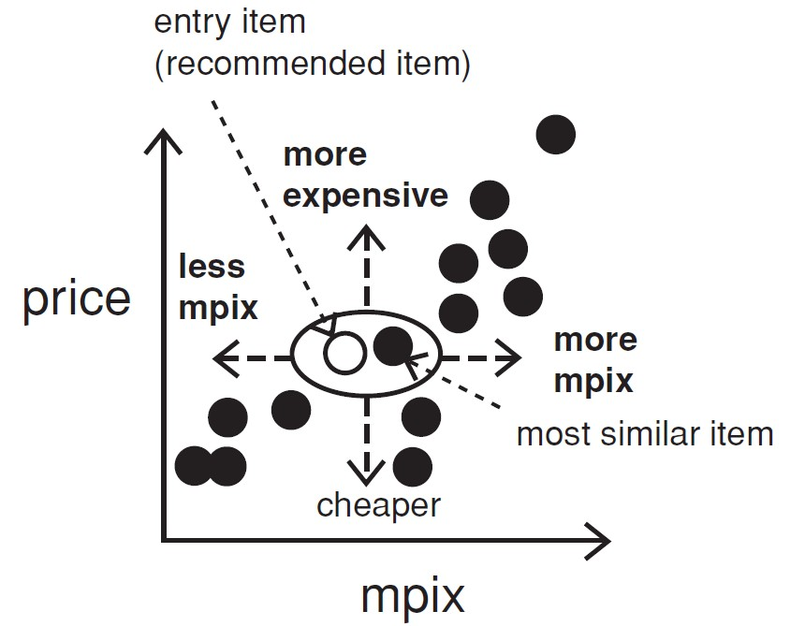
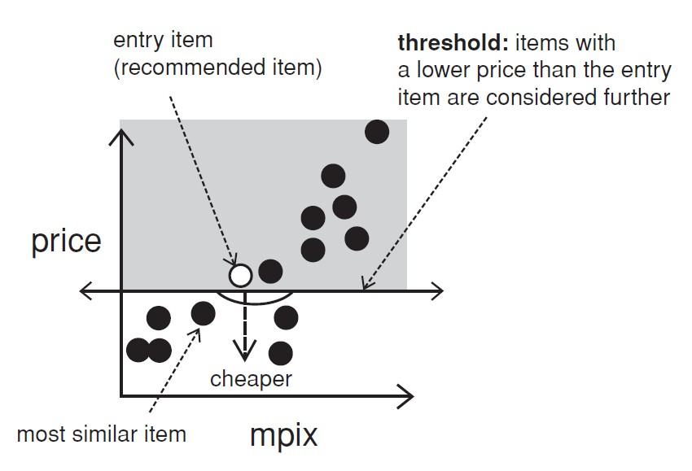
Interacting with case-based recommenders
Customers maybe not know what they are seeking
Critiquing is an effective way to support such navigations
Customers specify their change requests (price or mpix) that are not satisfied by the current item (entry item)
Critique on price

Slide 21
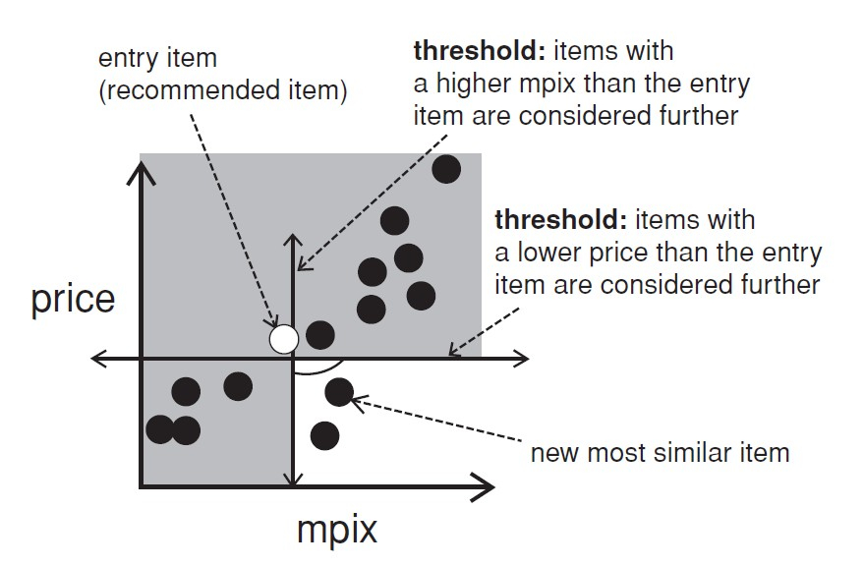
Compound critiques
Operate over multiple properties can improve the efficiency of recommendation dialogs

Slide 22
Dynamic critiques
Algorithm 4.4 DynamicCritiquing(q,CI)
Input: Initial user query q; Candidate items CI;
number of compound critiques per cycle k;
minimum support for identified association rules σ_{min}
procedure DynamicCritiquing(q, CI, k, σ_{min})
repeat
r ←ItemRecommend(q, CI);
CC ←CompoundCritiques(r, CI, k, σ_{min});
q ←UserReview(r, CI, CC);
until empty(q)
end procedure
procedure ItemRecommend(q, CI)
CI ← {ci ∈ CI: satisfies(ci, q)};
r ←mostsimilar(CI, q);
return r;
end procedure
procedure UserReview(r, CI, CC)
q ←critique(r, CC);
CI ←CI − r;
return q;
end procedure
procedure CompoundCritiques(r, CI, k, σ_{min})
CP ←CritiquePatterns(r, CI);
CC ←Apriori(CP, σmin);
SC ←SelectCritiques(CC, k);
return SC;
end procedure
Association rule mining
Basic steps for dynamic critiques
q: initial set of requirements
CI: all the available items
K: maximum number of compound critiques
σmin : minimum support value for calculated association rules.

Slide 23
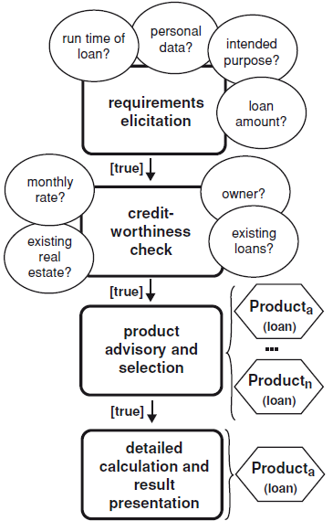
Example: sales dialogue financial services
In the financial services domain
sales representatives do not know which services should be recommended
improve the overall productivity of sales representatives
Resembles call-center scripting
best-practice sales dialogues
states, transitions with predicates
Research results
support for KA and validation
node properties (reachable, extensible, deterministic)

Slide 24
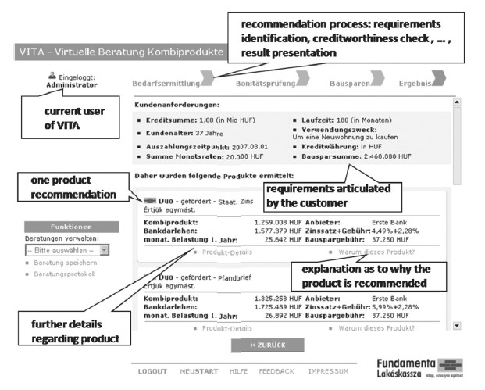
Example software: VITA sales support

Slide 25
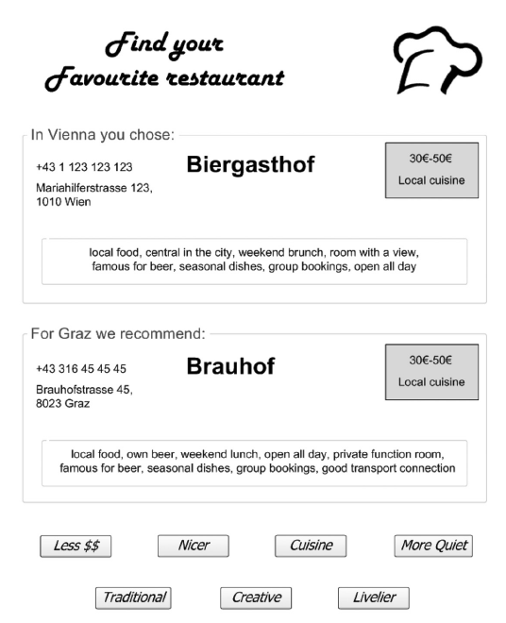
Example: Critiquing
Similarity-based navigation in item space
Compound critiques
more efficient navigation than with unit critiques
mining of frequent patterns
Dynamic critiques
only applicable compound critiques proposed
Incremental critiques
considers history
Adaptive suggestions
suggest items that allow to best refine user's preference model

Slide 26
Summary
Knowledge-based recommender systems
constraint-based
case-based
Limitations
cost of knowledge acquisition
from domain experts
from users
from web resources
accuracy of preference models
very fine granular preference models require many interaction cycles
collaborative filtering models preference implicitly
independence assumption can be challenged
preferences are not always independent from each other

